Slide 1
Unit 2
Servlet and JSP
Web development using Servlets

Slide 2
Syllabus…
Servlets: Introduction
Web application Architecture
Http Protocol & Http Methods
Web Server & Web Container
Servlet Interface
GenericServlet
HttpServlet
Servlet Life Cycle
ServletConfig
ServletContext
Servlet Communication
Session Tracking Mechanisms

Slide 3
jsp
JSP: Introduction
JSP LifeCycle
JSP Implicit Objects & Scopes
JSP Directives
JSP Scripting Elements
JSP Actions: Standard actions and customized actions

Slide 4
Servlet
Servlet technology is used to create web application (resides at server side and generates dynamic web page).
Servlet technology is robust and scalable because of java language. Before Servlet, CGI (Common Gateway Interface) scripting language was popular as a server-side programming language. But there was many disadvantages of this technology.

Slide 5
What is a Servlet?
Servlet is an API that provides many interfaces and classes including documentations.
Servlet is an interface that must be implemented for creating any servlet.
Servlet is a class that extend the capabilities of the servers and respond to the incoming request. It can respond to any type of requests.
Servlet is a web component that is deployed on the server to create dynamic web page.

Slide 6
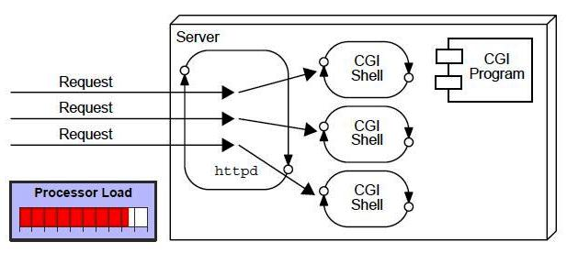
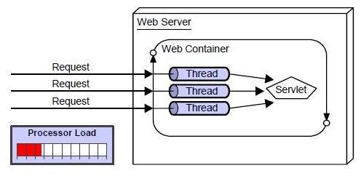
Servlet vs CGI
CGI technology enables the web server to call an external program and pass HTTP request information to the external program to process the request. For each request, it starts a new process.

Slide 7
Disadvantages of CGI
If number of clients increases, it takes more time for sending response.
For each request, it starts a process and Web server is limited to start processes.
It uses platform dependent language e.g. C, C++, perl.

Slide 8
Benefits of servlets
Better performance: because it creates a thread for each request not process.
Portability: because it uses java language.
Robust: Servlets are managed by JVM so we don't need to worry about memory leak, garbage collection etc.
Secure: because it uses java language..

Slide 9
Introduction – what is a request and response
HTTP Request HTTP Response
Key elements of a “request”
stream:
HTTP method (action to be
performed).
The page to access (a URL).
Form parameters.
Key elements of a “response”
stream:
A status code (for whether
the request was successful).
Content-type (text, picture,
html, etc…).
The content ( the actual
content).

Slide 10


Servlet Architecture -Web Container
What is a Web Container?
- Servlets don’t have a main method.
- They are under the control of another Java application called the “Container” (e.g. Tomcat)
request
GET.
…..
GET.
…..
GET.
…..
Web
Server
Web
Container
Servlet
Client

Slide 11
Servlet Architecture – Web Container
How does the Container handle a request?
Servlet
Web
Container
request
Http request
response
Web
Server
Thread
response
<Html>
<Body>
…….
</Body>
</Html>
Service()
Client
doGet()

Slide 12
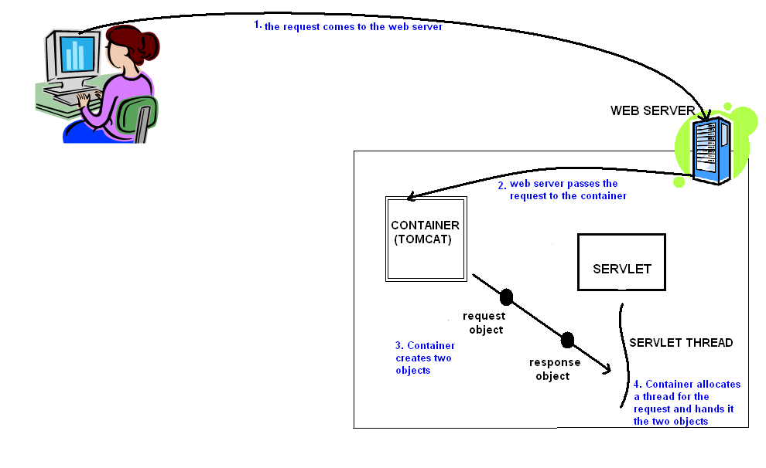
How it works??

Slide 13
Servlet Architecture – Web Container
The CONTAINER
What is the role of Web Container ?
Communication Support
Lifecycle Management
Multi-threading support
Security
JSP Support
S2
S1
JSP1
S3
S4
The container can contain multiple Servlets & JSPs within it

Slide 14
Servlet Lifecycle
The Servlet lifecycle is simple, there is only one main state – “Initialized”.
Does not exist
constructor()
destroy()
init()
Initialized
Service()

Slide 15
Servlet Lifecycle - Hierarchy
Interface
Servlet
Abstract class
GenericServlet
If not overridden, implements init()
method from the ‘Servlet’ interface,
Abstract class
HttpServlet
If not overridden, implements service()
method.
Concrete class
Your Servlet
We implement the HTTP methods
here.

Slide 16
Servlet Lifecycle – 3 big moments
 | When is it called | What it’s for | Do you override it
init() | The container calls the init() before the servlet can service any client requests. | To initialize your servlet before handling any client requests. | Possibly
service() | When a new request for that servlet comes in. | To determine which HTTP method should be called. | No. Very unlikely
doGet() or doPost() | The service() method invokes it based on the HTTP method from the request. | To handle the business logic. | Always

Slide 17
Servlet Lifecycle – Thread handling
The Container runs multiple threads to process multiple requests to a single servlet.
Container
Client A
Client B
Servlet
Thread
A
Thread
B
response
request
request
response

Slide 18
Request and Response – GET v/s POST
The HTTP request method determines whether doGet() or doPost() runs.
 | GET (doGet()) | POST (doPost())
HTTP Request | The request contains only the request line and HTTP header. | Along with request line and header it also contains HTTP body.
Parameter passing | The form elements are passed to the server by appending at the end of the URL. | The form elements are passed in the body of the HTTP request.
Size | The parameter data is limited (the limit depends on the container) | Can send huge amount of data to the server.
Idempotency | GET is Idempotent | POST is not idempotent
Usage | Generally used to fetch some information from the host. | Generally used to process the sent data.

Slide 19
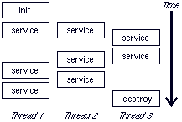
A Typical Servlet Lifecycle

Slide 20
Servlet Life Cycle Steps
Server loads the servlet
Creates 1 or more instances of class
Calls the init()
Servlet request is received
Calls the service method
Service() processes the request
Waits for next request or unloads it self
Use destroy() to unload.

Slide 21
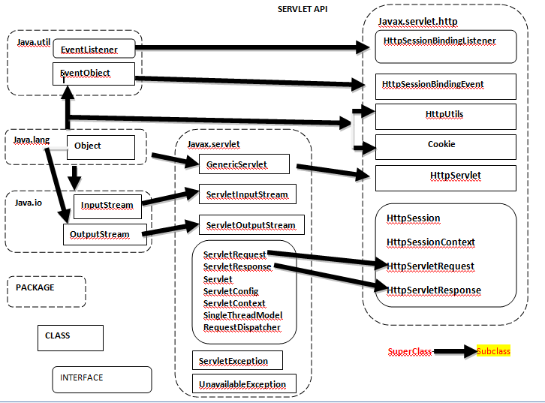

Slide 22
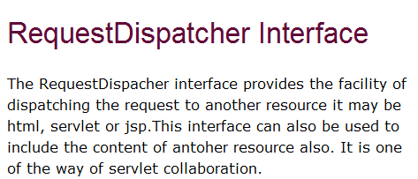

Slide 23
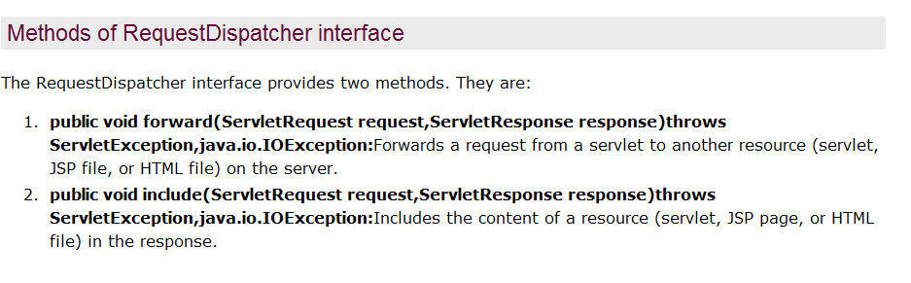

Slide 24
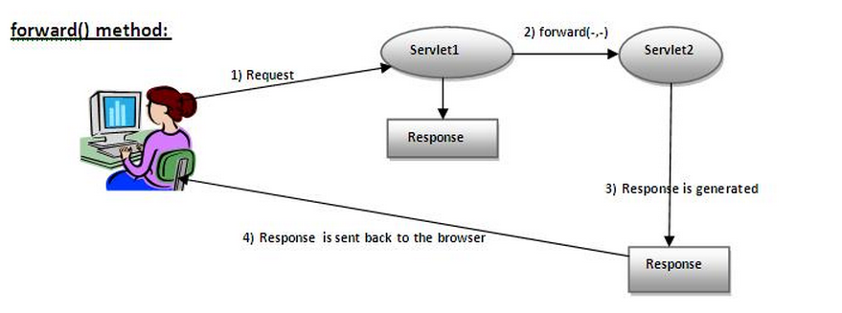

Slide 25
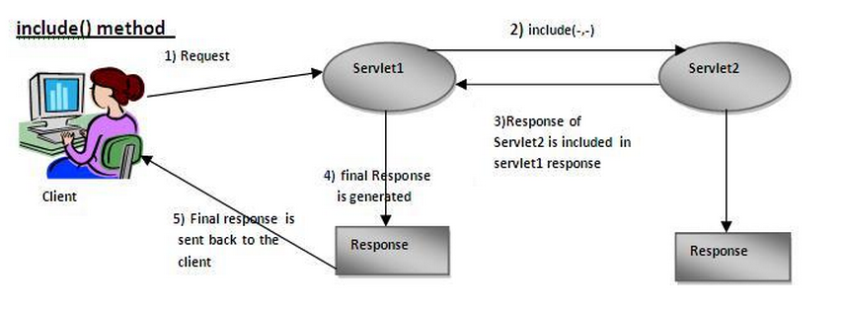

Slide 26
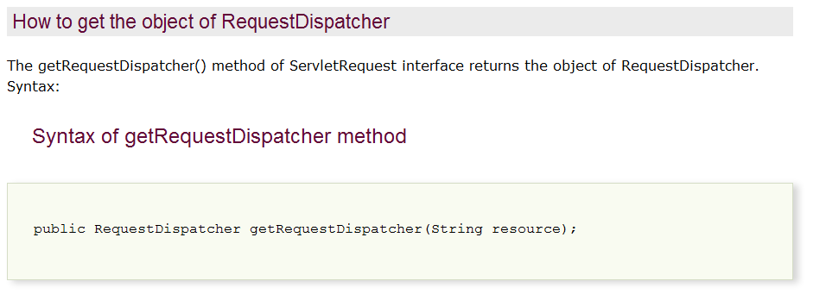

Slide 27
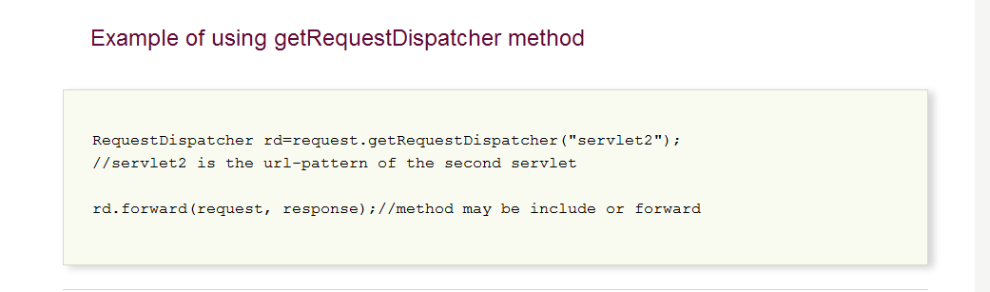

Slide 28
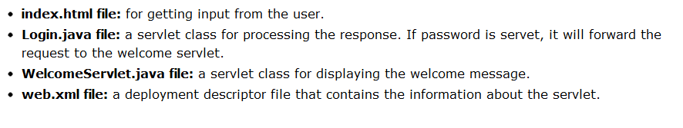

Slide 29
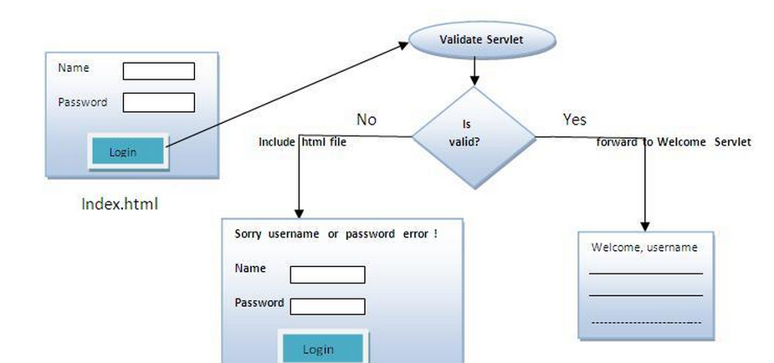

Slide 30
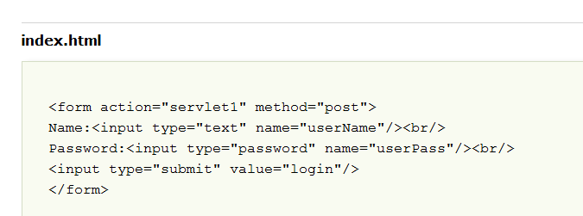
Index.html

Slide 31
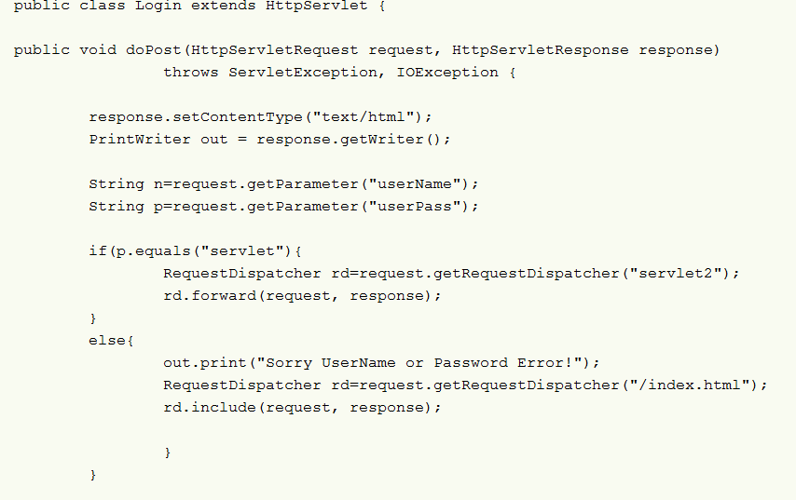

Slide 32
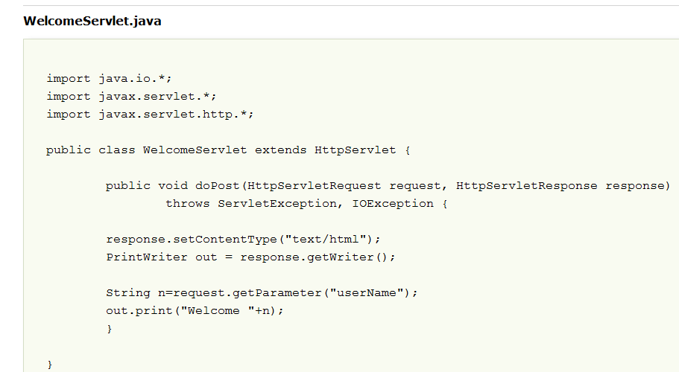

Slide 33
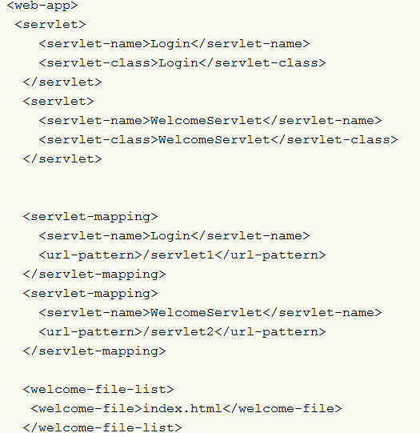
Web.xml

